Slide 1
New Marking System
European Schools
Monday, 16 April 2018
Training of Trainers

Slide 2

Programme
10:00 – 10:15 Welcome and Introduction: purpose of the day
10:15 – 11:00 Overview of Key Concepts
        Scale
        Competences, learning objectives, attainment descriptors
        Test design (Key Questions)
        Assessment plan
11:00 – 11:30 Points for clarification
11:30 – 12:45 Analysis of an harmonised S5-example
12:45 – 14:00 Lunch
14:00 – 15:00 Supporting harmonisation at school level
15:00 – 16:00 Follow-up: training of colleagues

Slide 3
Purpose of the day
At the end of the day you…
have a clear notion of the key concepts underpinning/central to the New Marking System
can apply the key questions for test design
know how you can support colleagues at your school in a certain content area
feel equipped to (co-)organise a similar training for your colleagues in your school
know where you can find help (documents, contact persons).
Focus on S5, but not exclusively.

Slide 4
Planning
Implementation

Slide 5
Timeline (1)
Step | School Year | Year Group
Step 1 | 2018-2019 | S1-S5
Step 2 | 2019-2020 | S6
Step 3 | 2020-2021 | S7

Slide 6

Timeline (2)
1. Guidelines, including Generic examples
↓
2. Subject specific examples on 2 levels:
School based for Cycle 1 (S1-S3; 1st Training Day)
Inspector led for S5 harmonized exam
↓
3. Centralised training of teacher trainers
↓
4. School-based training
(Separate meetings within schools; 2nd Training Day)
School year 2017-2018
Cycle 1
Cycle 2
School year 2018-2019
Cycle 3

Slide 7
Basic Concepts

Slide 8

 | Grade (S1-S3) | Numerical Mark (S4-S6) | Numerical mark 1 decimal S7 preliminary mark | Numerical mark 2 decimals S7 final mark | Performance Indicator
Excellent though not flawless performance entirely corresponding to the competences required by the subject | A | 10 9.0-9.5 | 9.0-10 | 9.00-10 | Excellent
Very good performance almost entirely corresponding to the competences required by the subject | B | 8.0-8.5 | 8.0-8.9 | 8.00-8.99 | Very good
Good performance corresponding overall to the competences required by the subject | C | 7.0-7.5 | 7.0-7.9 | 7.00-7.99 | Good
Satisfactory performance corresponding to the competences required by the subject | D | 6.0-6.5 | 6.0-6.9 | 6.00-6.99 | Satisfactory
Performance corresponding to the minimum of the competences required by the subject | E | 5.0-5.5 | 5.0-5.9 | 5.00-5.99 | Sufficient
Weak performance almost entirely failing to meet the competences required by the subject | F | 3.0-4.5 | 3.0-4.9 | 3.00-4.99 | Failed (Weak)
Very weak performance entirely failing to meet the competences required by the subject | FX | 0-2.5 | 0-2.9 | 0.00-2.99 | Failed (Very weak)
Marking Scale

Slide 9
Reporting
Cycle | Continuum | Reporting
Primary Cycle | Grades: 4 | ++++ +++ ++ +
Secondary Cycle: S1-S2-S3 | Grades: 7 | A B C D E F Fx
Secondary Cycle: S4-S5-S6 | Marks: 1-10 | 10 9.5 9 8.5 8 7.5 7 etcetera (whole and half marks) Grades optional
Secondary Cycle: S7 | Marks: 1-10 | e.g. 10 9.9 9.8 9.75 (Marks with 1 and 2 decimals)
(see General Rules – Ref.: 2017-01-D-13-en-7)

Slide 10
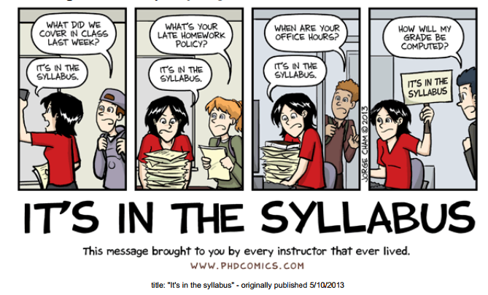
Syllabi
1. General Objectives of the European Schools
2. Didactic Principles
3. Learning Objectives
4. Contents
5. Assessment
Attainment descriptors
6. Annexes
Sample Baccalaureate examination paper

Slide 11
Attainment descriptors
A set of generic statements which describe levels of attainment in respect of a given set of competences or learning objectives.
Are related to the marking scale.
Are used for the planning of teaching, learning and assessment.
Can provide a basis for marking with the addition of some quality indicators.

Slide 12
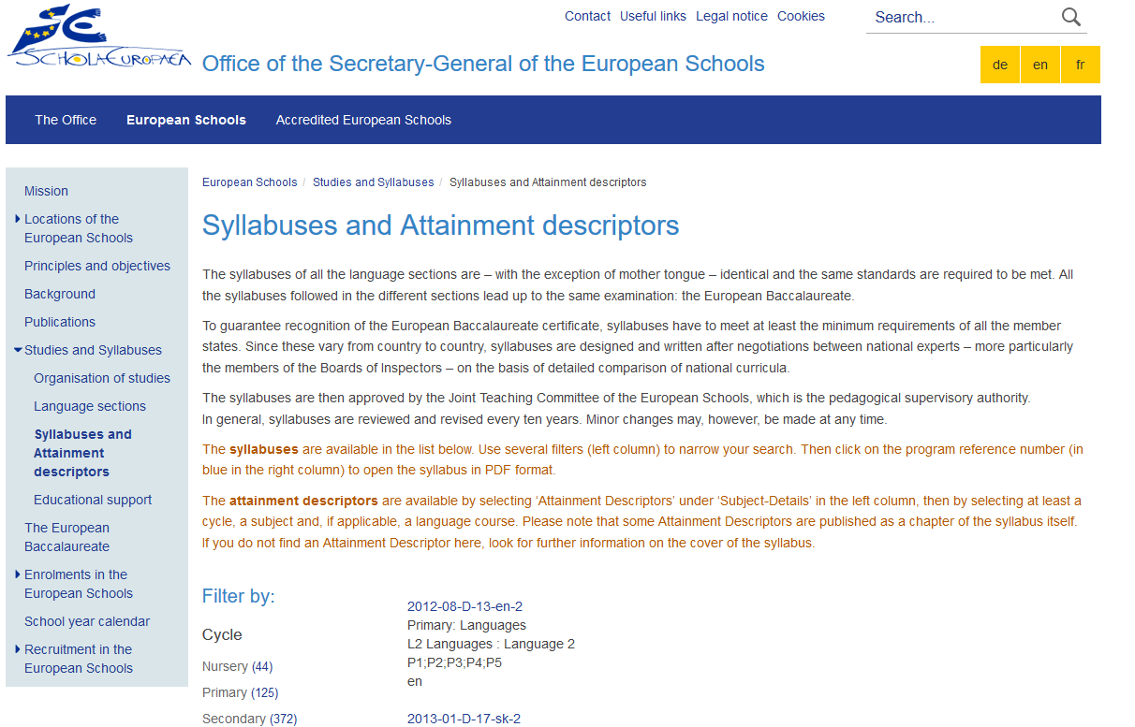

Slide 13
Example Attainment Descriptors (1)
Example L1
Mark | Grade | Perfor-mance Indicator | Compe-tence | End of Cycle 1 | End of Cycle 2 | End of Cycle 3
9-10 | A | Excellent | Reading (compre-hension) | The student shows excellent – though not flawless – understanding of literary/non-literary text(s) at the S3 level; (s)he is capable, under the teacher’s guidance, of recognising and using relevant information, including important details, excellently. | The student shows excellent – though not flawless – understanding of literary/non-literary text(s) at the S5 level; (s)he is capable, with instructions, of recognising, using and analysing relevant information, including important details, excellently. | The student shows excellent – though not flawless – understanding of literary/non-literary text(s) at the S7 level; (s)he is capable, without further instructions, of recognising, using and analysing relevant information, including important details, excellently.
8-8.9 | B | Very Good | Reading (compre-hension) | The student shows very good understanding of literary/non-literary text(s) at the S3 level; he/she is capable, under the teacher's guidance, of recognising and using relevant information, including important details, very well. | The student shows very good understanding of literary/non-literary text(s) at the S5 level; he/she is capable, with instructions, of recognising, using and analysing relevant information, including important details, very well. | The student shows very good understanding of literary/non-literary text(s) at the S7 level; he/she is capable, without further instructions, of recognising, using and analysing relevant information, including important details, very well.

Slide 14
Example Attainment Descriptors (2)
Example Science

Slide 15
Guidelines for use
of the Marking System

Slide 16
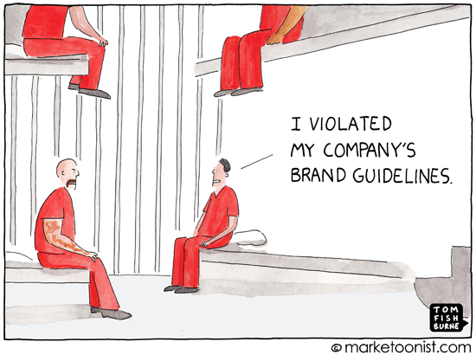
‘Guidelines’
Not a prescriptive manual.
No mandatory rules or prescriptions.
An evolving document.
Offer additional support to
schools and teachers:
Definitions;
Descriptions;
Explanations;
Tools;
Examples.

Slide 17

Content table - Guidelines
1. Introduction
2. Marking System
3. Terminology
4. Planning for teaching, learning and assessment
4.1. Syllabuses
4.2. Planning
5. Assessment Tools and Assessment Tasks
5.1. Preparation process
5.2. Attainment Descriptors
5.3. Construction of assessment tools
5.4. Translation of test points into grades and/or marks
5.5. Final grades/marks at the end of the school year
6. School reports
7. Baccalaureate
8. Frequently asked questions
Annexes: Generic examples

Slide 18
Terminology
Criteria referenced:
Criteria referenced assessment measures pupils’ attainment in relation to the level at which the learning objectives defined in a given syllabus have been achieved.
Marking Scale:
A graduated ranking of marks, which operate between a base and an optimal number.
Marking Scheme:
A set of instructions (e.g. rubrics, possible answers, etc.) for how to evaluate or correct performances in response to the stimuli in a test.
Norm referenced:
Norm referenced assessment compares and ranks pupils in relation to one another.
Production:
A task which requires the student to create a response by, for example, interpreting or analysing material/data or by transferring or applying knowledge.
Reproduction:
A task which requires the student to simply give a response recalling/reproducing specific knowledge already learned.

Slide 19
Teaching, Learning and Assessment
Syllabus
Learning Objectives
Teaching and Learning Activities
Assessment
Reporting
Planning for Teaching, Learning and Assessment
Evaluation/
Review of Process

Slide 20
Key Questions - Assessment
What do I want to assess
(and for what reason)?
How will I assess?
What will my test look like?
How will I evaluate the student’s performance?
How will I report on performance / overall performance?

Slide 21
Test Design
or
Test Matrix
Example

Slide 22
Example 1 Marking Scheme / rubric
Aspects for judgement | 5 points | 4 points | 3 points | 2 points | 1 point
Plan for Investigation | The plan is thorough. | The plan is lacking a few details. | The plan is just acceptable. | The plan is missing major details. | The plan is incomplete and limited.
Use of Materials | Manages all materials responsibly. | Uses the materials responsibly most of the time. | Use of the materials is just acceptable. | Mishandles some of the materials. | Does not use materials properly.
Collection of Data | Thorough collection, according to standards for research | Most of the data are available and collected according to standards for research. | Some of the data are available; research standards are not fully met. | Major portions of the data are missing; research standards are only partially met. | The data collection consists of a few points; research standards are not met.
Analysis of Data | Excellent analysis; standards of subject and of statistics are met in a professional way | Good analysis; standards of subject and statistics are mainly met. | Satisfactory analysis; standards of subject and statistics are met, but can be improved. | Sufficient analysis, but significant parts are missing; standards of subject and statistics are sufficiently met but deserve improvement | Poor analysis, standards of subject and statistics are hardly met and need improvement.
Reporting of Results | Communicates highly logically and concisely about hypotheses, investigation and results. Demonstrates excellent presentation skills. | Communicates clearly using scientific vocabulary correctly. Demonstrates good presentation skills. | Uses basic scientific vocabulary. Descriptions show satisfactory structure and clarity, but this can be improved. Demonstrates satisfactory presentation skills. | Uses basic scientific vocabulary. Descriptions lack structure and/or clarity; this deserves improvement. Demonstrates sufficient presentation skills, but skills deserve improvement. | Poor communication. Presentation skills need improvement.

Slide 23
Example 2 Marking Scheme / rubric

Slide 24

Threshold: pass or fail ?
How to determine a threshold?
Attainment descriptors are the basis for
determining the pass – fail threshold!
(Be aware: this does not have to be 50% of a number of points.)

Slide 25
Example translation of test points into
grades and/or marks

Slide 26
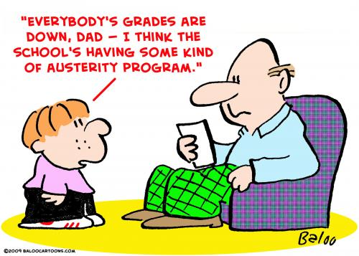

Drop in standards ?
6,0
A.D. – “Sufficient”
5,0
Student who would like to achieve a
“Satisfactory”
A.D.
6,0
6,0
“Sufficient”
USE OF ATTAINMENT DESCRIPTORS IS ESSENTIAL !

Slide 27
Final grades/marks – Assessment plan

Slide 28
Important documents
Guidelines for use of the new marking system
(2017-05-D-29-en/fr/de-5)
Harmonised assessment at the end of year 5 and written examinations leading to B marks in year 5
(2018-01-D-19-en-1)
General Rules
(2017-01-D-13-en-7)

Slide 29



Points for clarification?

